Slide 1

Emotion-Aware Chatbot: Sentiment Analysis and Empathetic Responses
``
By:
Sai Siri Tammineni (A04313333)
Greeshma Reddy Bokka (A04318920)
Prasanna Potu (A04314318)
Panthangi Kiranmayee Goud (A04324454)
Notes:
Line spacing + Page numbers

Slide 2

Contents
01 Introduction
02 Project Objective
03 Methodology
04 Implementation
05 Evaluation
06 Result
07 Conclusion
08 References

Slide 3

Introduction
Developed a Sentiment-Aware Chatbot using BERT
Integrated Human-Computer Interaction (HCI) principles to design a user-centered, emotionally intelligent chatbot.
Applied Natural Language Processing (NLP) techniques to detect and classify user emotions in real-time conversations.
Generated empathetic and contextually appropriate responses tailored to the user's emotional state.
Enhanced user engagement, satisfaction, and trust by making interactions feel natural and emotionally aware.
Target applications include customer service support, mental health counseling, and educational platforms.

Slide 4
Project Objectives
User-Centered Chatbot Created a chatbot that understands users' emotions and gives friendly, empathetic responses based on what users prefer.
Sentiment Analysis Used advanced models like BERT to detect emotions like fear, Joy, sad, anger from users' messages in real-time.
Performance Evaluation Checked how well the chatbot works by measuring accuracy, precision, recall, and asking users for their feedback about the chatbot’s emotional understanding.
Full Documentation Prepared a complete report that explains how the chatbot was designed, built, tested, and how it can be improved in the future.

Slide 5
Design Overview (HCI Perspective)
User-Centered Design Designed the chatbot based on what users want and expect, especially how they express emotions.
Affective Computing Teach the chatbot to recognize emotions and respond in a caring and natural way.
Prototyping Build simple models (prototypes) of the chatbot and test them with users to make the chatbot better.
Emotional Interaction Preferences Understand how users like to talk about emotions and adjust the chatbot’s style (friendly, expressive, or formal) to match them.

Slide 6
Methodology
Dataset:
”ISEAR.csv”
Model:
Pre-trained BERT fine-tuned for emotion classification.
Workflow:
Load dataset.
Fine-tune BERT model.
Implement real-time chatbot loop.
Tokenize user inputs → Predict emotion → Respond empathetically based on prediction.

Slide 7
Prototyping and User Testing
Developed mobile-responsive prototypes to make sure the chatbot works well on smartphones, since most users preferred mobile access.
After testing, 71.5% of users rated their satisfaction as 4 or 5 out of 5, showing that the chatbot was easy to use, emotionally responsive, and enjoyable to interact with.
No users gave low satisfaction scores (1 or 2), which shows strong overall acceptance of the chatbot design.

Slide 8
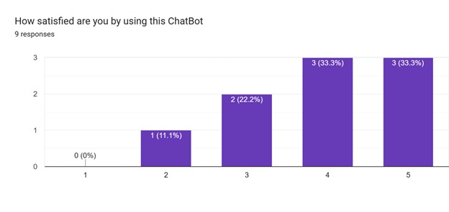

Slide 9
Implementation
Dataset Collection: Carefully selected the ISEAR dataset containing emotionally labeled text to train the chatbot on real human emotions like fear, Joy, sad and anger .
Model Selection: Chose the BERT model, a powerful pre-trained NLP model, and fine-tuned it for emotion classification to ensure high accuracy in detecting user emotions.
Chatbot Integration: Integrated the trained BERT model into the chatbot system, enabling real-time emotion detection and generating responses that match the emotional tone of the conversation

Slide 10
Model Selection and Fine-tuning (BERT)
Model Selection and Fine-Tuning
Fine-tuned the BERT model for 2 epochs with a batch size of 16.
Improved emotion detection by adjusting the pre-trained model to our dataset.
Used mixed-precision training for faster and more efficient model performance.

Slide 11
Model training
Fine-tuned BERT model on the ISEAR dataset for emotion classification.
Trained over 2 epochs with a batch size of 16.
Training loss steadily decreased from 1.19 to 0.22, showing effective learning.
Used dynamic learning rates and mixed-precision training for faster and efficient processing.
Achieved smooth convergence within about 45 minutes of training.

Slide 12
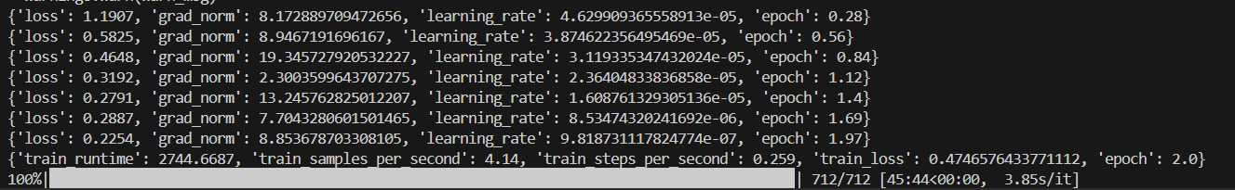

Slide 13
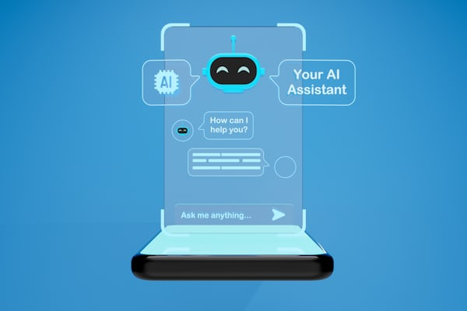
Evaluation
Achieved High accuracy for certain emotions like sadness and anger.
Occasional misclassifications (e.g., fear misread as joy).
Overall, chatbot showed empathetic responses aligned with predicted emotions.
Confidence levels mostly >60%, with sadness detection reaching 98%.

Slide 14
Model Evaluation (Metrics, Confusion Matrix)
Model Evaluation Metrics
Evaluated the BERT model using key performance metrics: accuracy, macro precision, macro recall, and macro F1-score to measure overall classification quality across all emotions.
Accuracy shows how often the model predicted the correct emotion.
Precision measures how correct positive predictions were, while recall checks how many actual emotions were successfully captured.
F1-score balances both precision and recall to give a complete view of performance.
Confusion Matrix Analysis was used to visualize where the model made mistakes, identifying emotions that were commonly confused, such as sadness and fear.
.

Slide 15
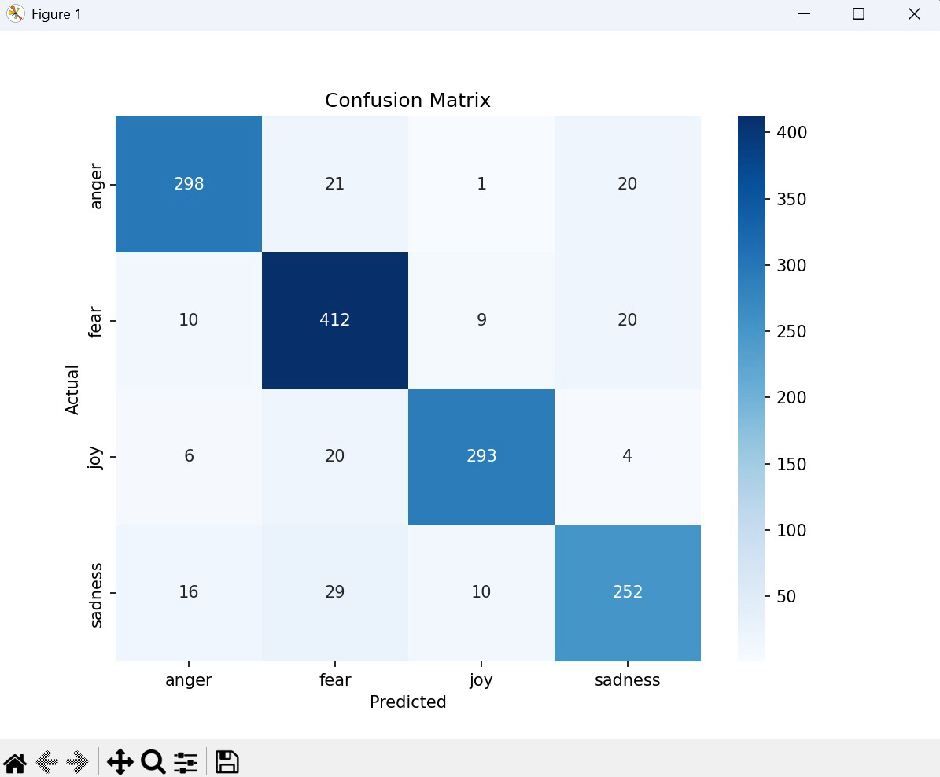

Slide 16
Result
Chatbot Response Results
The chatbot accurately detected emotions like sadness, joy, anger, and fear from user inputs.
It provided empathetic, emotion-specific responses to user statements.
Positive emotions (joy) and negative emotions (anger, fear, sadness) were handled appropriately.
Demonstrates the chatbot’s capability for emotion-aware conversation using sentiment analysis.

Slide 17
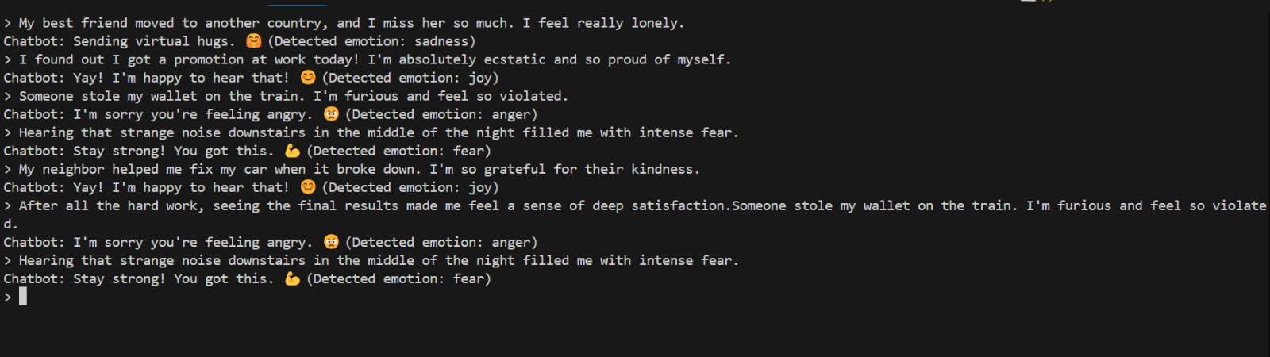

Slide 18
Final Model Evaluation
Achieved Overall Accuracy: 88.32% and Macro F1-score: 88.25%.
High precision and recall across all emotions:\n - Anger: F1-score 0.89\n - Fear: F1-score 0.88\n - Joy: F1-score 0.92\n - Sadness: F1-score 0.84
Shows strong and balanced performance after model improvements using BERT.

Slide 19
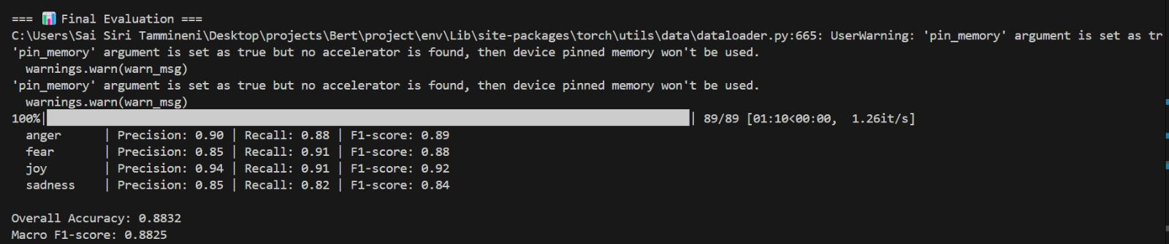

Slide 20
Conclusion
Achievements:
Built a BERT-based emotion-aware chatbot.
Provided empathetic responses based on emotion detection.
Demonstrated real-time prediction and interaction.
Future Work:
Further fine-tune the model to improve classification.
Expand response templates for more natural conversations.
Integrate graphical/voice interfaces.

Slide 21

References
Hugging Face Transformers: Huggingface
BERT: Devlin et al., 2018
Dataset: ISEAR Dataset

Slide 22
Thank you

